Slide 1

Government Polytechnic Nanded
Capstan Project Planning(22058)
Academic Year:2023-2024
Title : Online Bonafide and TC Certificate automation
Program : Information Technology
Mentor : A.T.Adhave
Prepared By:
1)Nikita Mandale
2)Vaishnavi Jadhav
3)Tejasvi Raut

Slide 2

Introduction:
The Problem:
Manual processes for Bonafide and TC certificates lead to delays and inconvenience for students.
Key Objectives:
Efficiency: Streamline the application process.
Accessibility: Provide a user-friendly platform.
Automation: Expedite certificate generation.
Our Vision:
Our vision is to transform this cumbersome process into a seamless and user-friendly experience through the implementation of "Online Bonafide and TC Certificate Automation."
Experience a New Era in Certificate Issuance with Our Brief Demo!

Slide 3
Significance of Project
Enhancing student experience
User friendly Interface
Measurable Impact
Significance of Project
Administrative efficiency
Emergency Situations
Audit trail and security

Slide 4
Project inspiration:
Recognizing Challenges: Identifying inefficiencies in the traditional certificate issuance process.
Personal Connection: Personal experiences with delays in obtaining certificates.
Aspiring for Solutions: Motivated as IT students to contribute solutions for improvement.
Positive Impact Vision: Envisioning a positive impact on peers facing similar challenges.

Slide 5



Key Features:
1)Seamless application process:
Effortless and continuous application process .
Reduces complexity making it easy for students to apply.
2)Automated certificate generation:
Certificates are generated automatically by the system.
Speeds up the process,reduces manual work.
3)Provides an easy to navigate:
User friendly Interface interface for students.
Ensures accessibility for all students.

Slide 6


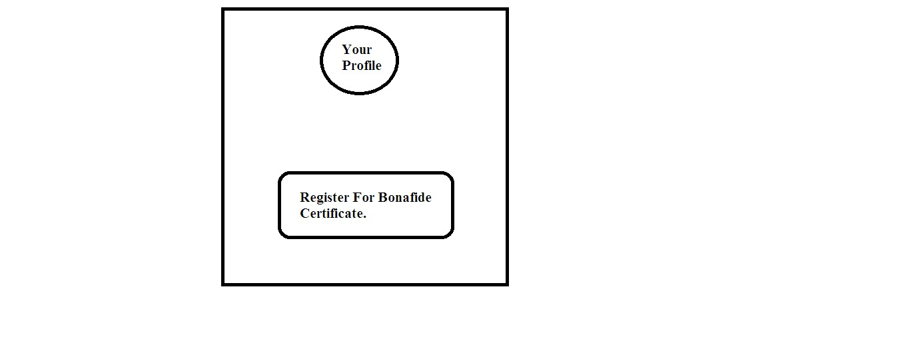


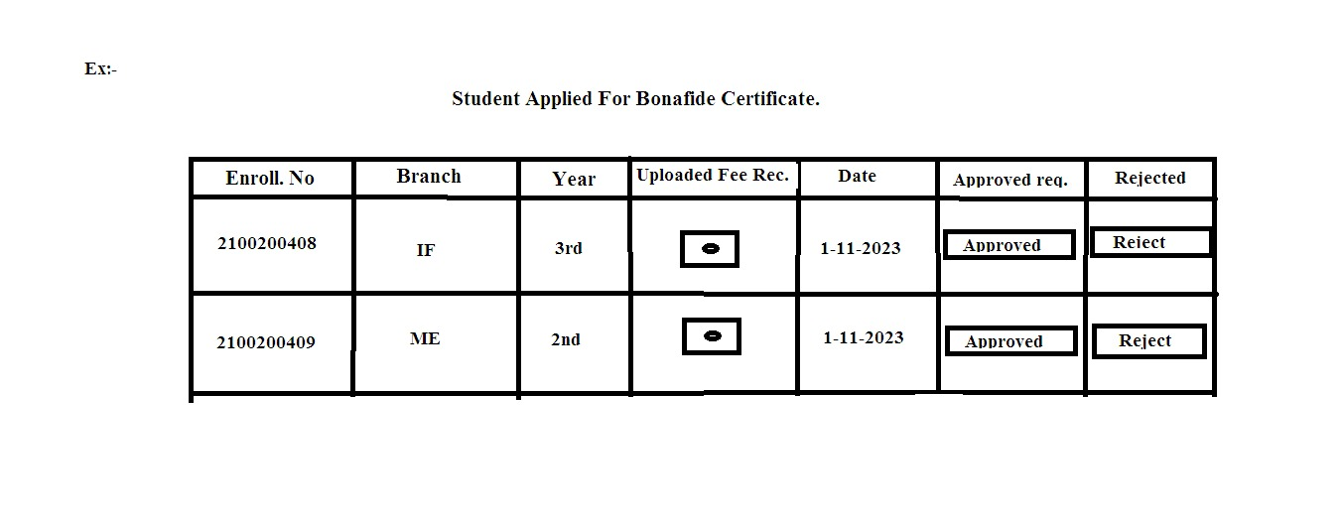
Demo:

Slide 7

Target audience:
1.Students:
The primary users of the platform seeking Bonafide and TC certificates.
Benefits: Quick and convenient access to essential certificates.
2. Administrative Staff:
Those responsible for managing and approving certificate requests.
Benefits: Streamlined processes, reduced administrative workload.
3. Institute Authorities:
Decision-makers overseeing the certificate issuance system.
Benefits: Enhanced efficiency, better data management.
Broad Impact:
The platform caters to a diverse audience within the academic institution, ensuring a positive impact on the overall administrative and student experience.

Slide 8
Future Scope:
Extended Certificate Types: Explore the inclusion of additional certificate types beyond bonafide and TC certificate Enhanced.
User Interface: Focus on improving the user interface for a more intuitive experience.
Integration with Academic Systems: Explore opportunities for integration with other academic systems for seamless data flow.
Mobile Application Development: Consider developing a mobile application for on-the-go certificate requests.
User Feedback Mechanism: Implement a system for collecting and incorporating user feedback for continuous improvement.

Slide 9
Conclusion:
1.Recap of Key Achievements:
Our journey through the "Online Bonafide and TC Certificate Automation" project showcased a significant leap in streamlining the certificate issuance process.
2. Impact on Students and Administration:
Witnessing the impact on both students and administration, we've witnessed a transformative shift towards efficiency and convenience. Students now experience a simplified application process, while administrators benefit from reduced workload and improved data management.

Slide 10
Thank you!
A heartfelt thank you for being part of this presentation. Your time and attention are greatly appreciated. We believe in the positive change this project can bring, and we're excited about the journey ahead.
Contact
Email: nikitamandale368@gmail.com
Phone:9604022646

